Slide 1
Equalizing a Turbid Water Channel
Luke Rumbaugh
Notes and simulations for discussion
21 May 2017

Slide 2
Results summary
Maximum Transmission Range in Turbid Water SNR = 20 dB; Maximum allowable BER is 10⁻⁵
Bandwidth | Unequalized | Equalized
f_{s}/2 | 12 cz | 14 cz
f_{s}/4 | 14 cz | 20 cz
f_{s}/6 | 17 cz | 29 cz
cz: one attenuation length, where c is the extinction coefficient in [1/m] and z is the distance traveled in [m]

Slide 3
Goal: Equalize turbid water channel
Method:
Postulate channel model: Model each experimental channel using a 3-parameter IIR filter model
Automatically identify channel parameters: Send training data through channel; determine 3 parameters with nothing known ahead of time
Equalize: Build equalizing filter to invert channel model filter
Metric: bit error rate of BPSK system
Run BPSK data through experimental channel, then through equalizer based on channel model
Compare equalized performance to unequalized

Slide 4
Plots: Channel model and BPSK performance at each turbidity
Channel model
BPSK performance
Model parameters are calculated by adaptive estimation routine, using a training sequence and experimental impulse responses measured in Summer 2016
Z-plane shows poles and zeros of channel model, which is used for equalizer
Varying SNR
Bandwidth is fixed as indicated, where fs is 2.2 GSPS
SNR varies from 0 to 30 dB
10^-6 is best error rate possible
Varying bandwidth
SNR is fixed at 20 dB
Bandwidth used varies from [0 to fs/2] to [0 to fs/16]
X axis is reduction ratio D, where bandwidth is [0 to fs/(2*D)]

Slide 5
Results: Following slides
Clear water – 0<cz<10 No scattering or single scattering To the digital receiver, it looks like all light arrives at exactly 0 samples delayed (relative to speed of light in water)
Turbid water – 14<cz<20
Most light arrives delayed by 0 or 1 samples
Very turbid water
Most light arrives delayed by 2 or more samples

Slide 6
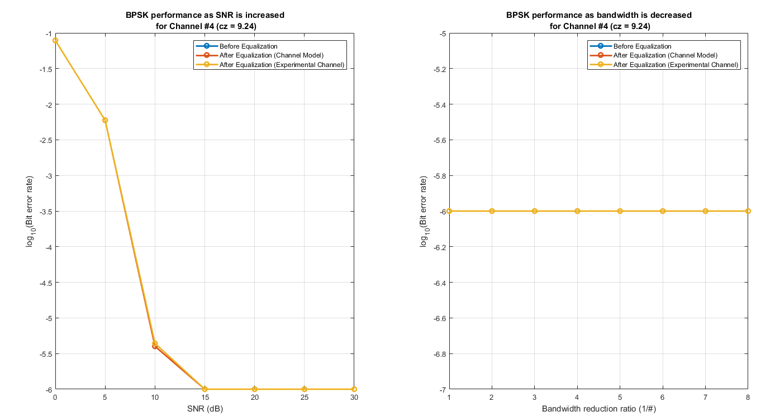
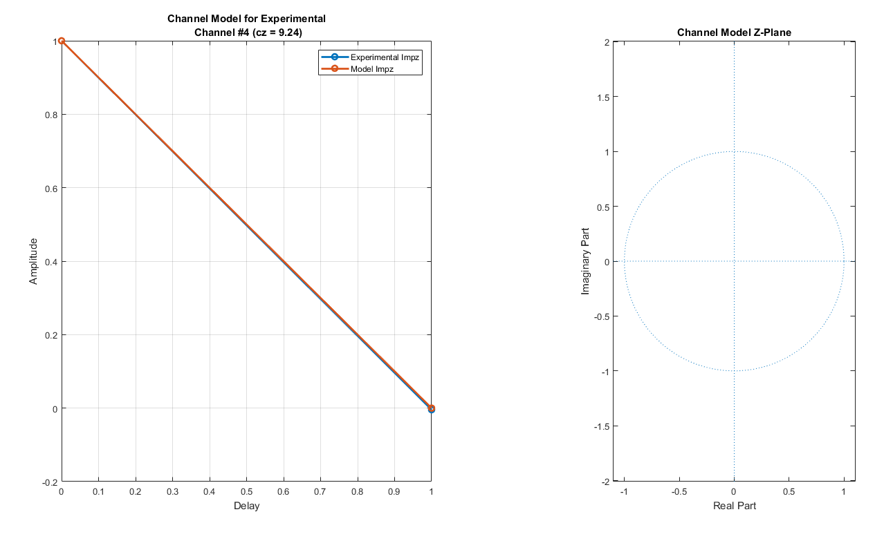
There is no problem in clear water
Single scattering
Impulse response is a delta function
No significant temporal corruption of signal through channel
Max data rate is fs/2 with no ISI
Typical for cz<10
BPSK simulated data transmission for clear water (cz = 9) Left: Bit error rate (BER) versus SNR is BPSK ideal for unequalized and equalized channels. Right: All bandwidths can be used, up to the maximum of fs/2 = 1100e6 symbols per second.
Channel for clear water (cz from 0 to 10) Left: Impulse response is a delta (i.e. perfect): zero everywhere except at zero delay. Right: Model has no non-zero zeros or poles.

Slide 7
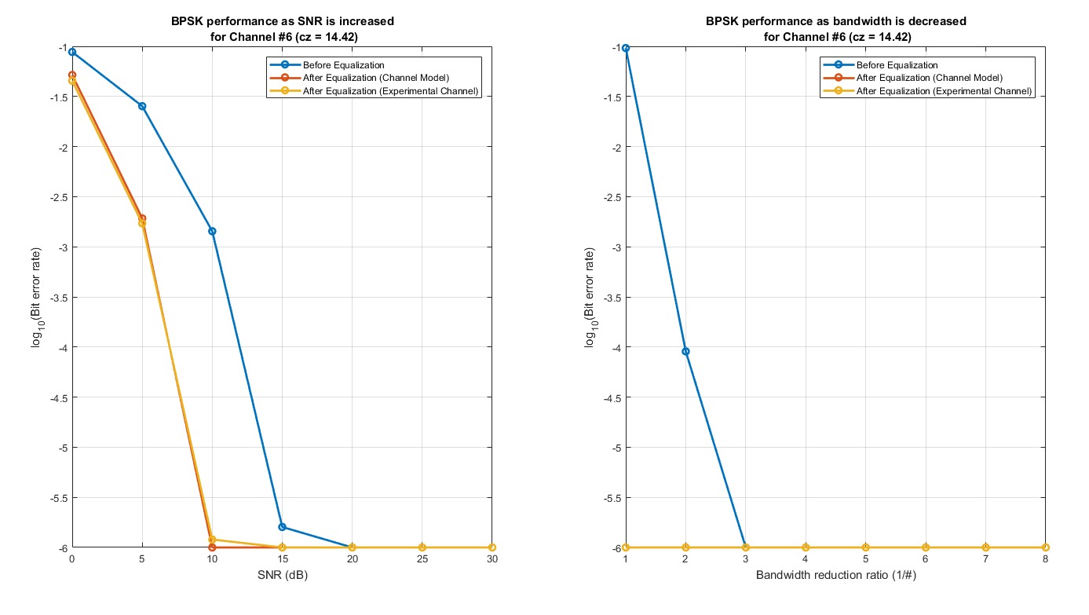
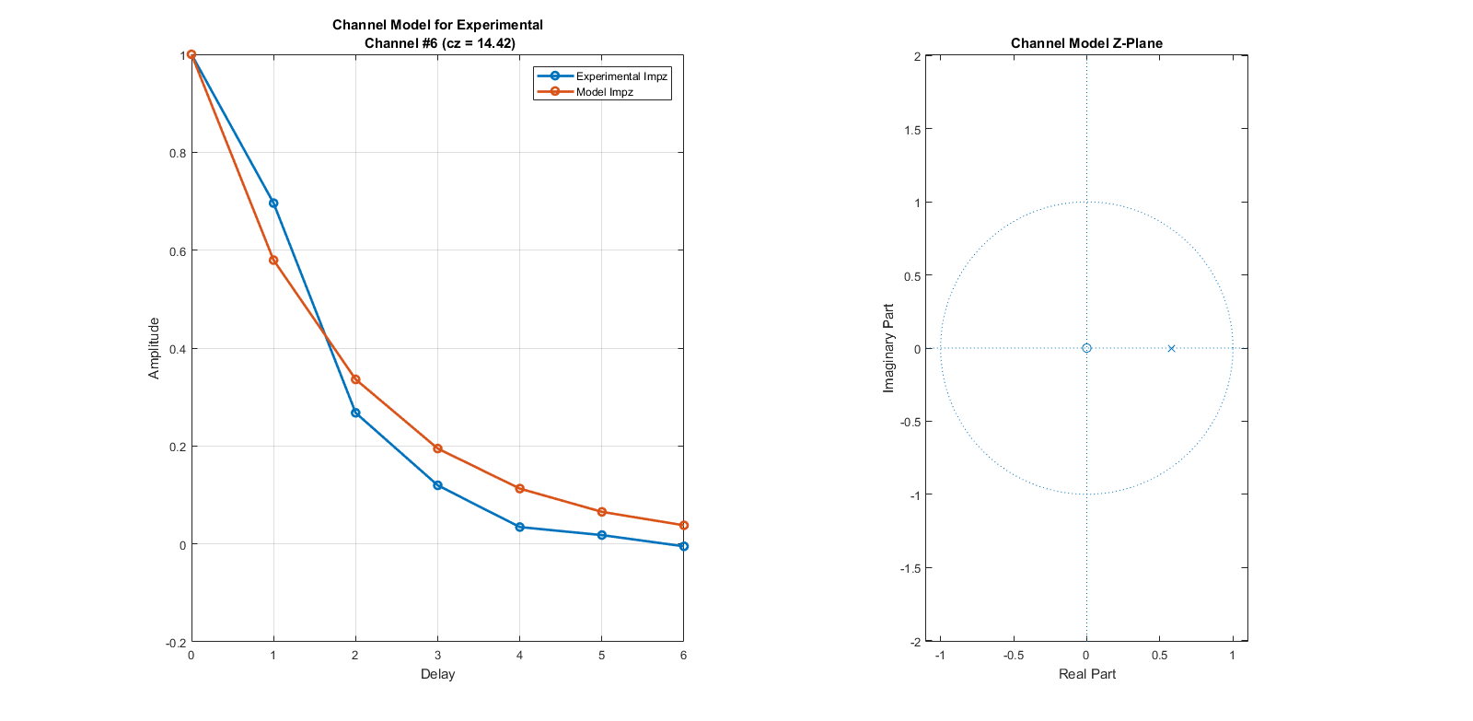
There is a problem in turbid water
Multiple scattering becomes strong
Trend: more light appears in delayed samples of impulse response
Significant ISI observed, forcing reduction in bandwidth without equalization
BPSK simulated data transmission for turbid water (cz = 14.5) Left: Bit error rate (BER) versus SNR is degraded for unequalized channel. Equalization can return performance to BPSK ideal, albiet at reduced data rate of fs/4. Right: In the equalized case, all bandwidths can be used, up to the maximum of fs/2 = 1100e6 symbols per second. (This is for SNR = 20 dB.)
Channel for turbid water (cz around 14.5) Left: Impulse response has significant amplitude at 1 and 2 sample delays, leading to ISI for symbol duration of 1, 2, and 3 samples. (i.e. bandwidths of fs/2, fs/4, and fs/6. Right: Model has a pole representing the decay in impulse response.

Slide 8
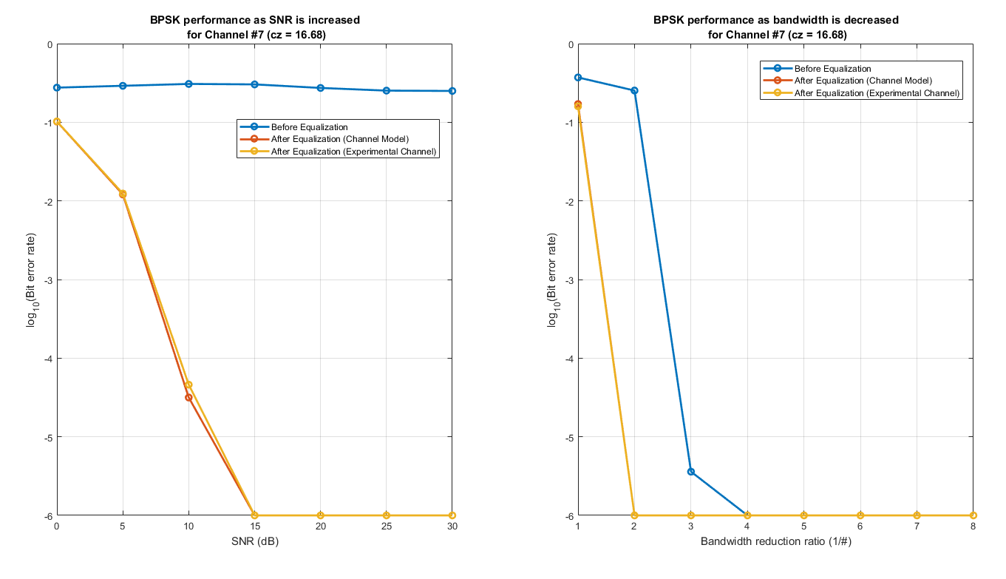
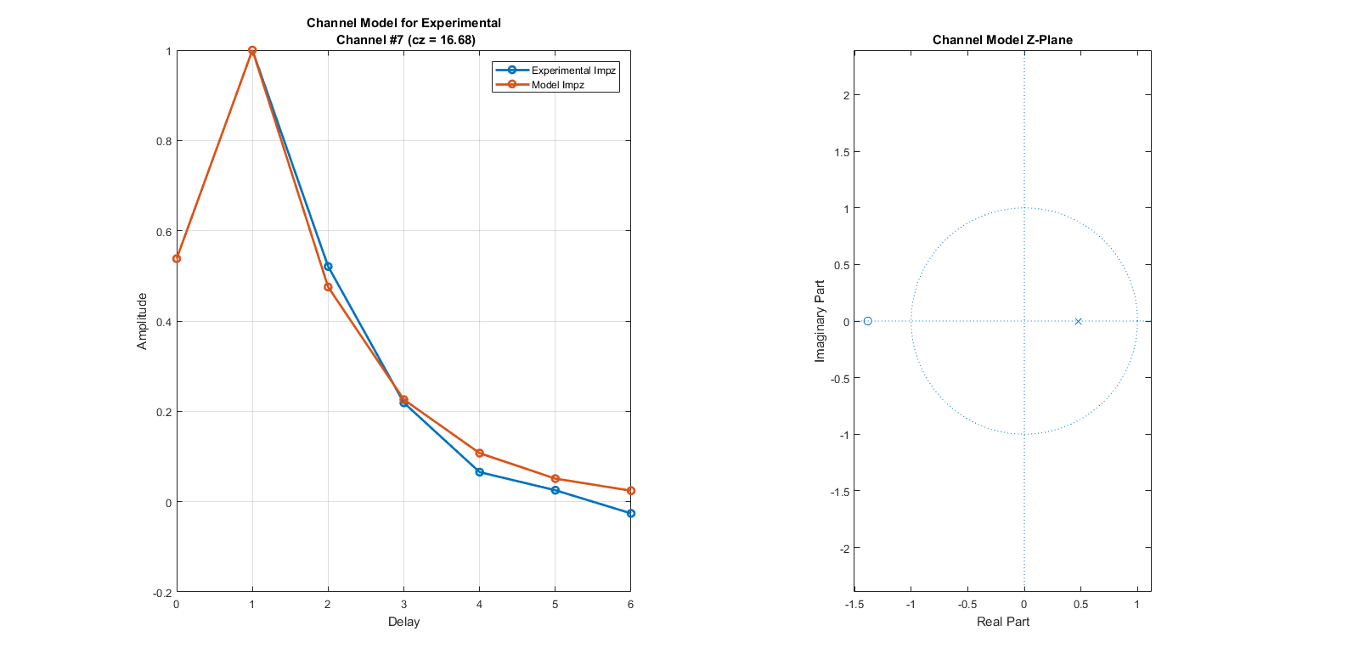
There is a problem in turbid water, part 2
Multiple scattering dominates
Growing trends: more light appears in delayed samples, and peak of impulse response eventually shifts to the right
Significant ISI observed, forcing reduction in bandwidth
BPSK simulated data transmission for turbid water (cz = 17) Left: For bandwidth of fs/4, data transmission is impossible in unequalized channel. Equalization allows good performance. Right: In the equalized case, the data rate must be reduced to fs/4; in the unequalized case, to fs/6. (This is for SNR = 20 dB.)
Channel for turbid water (cz around 17) Left: Impulse response has shifted peak, and slow roll-off, leading to strong ISI. Right: Model has a pole representing the decay in impulse response, and a zero representing the peak delay.

Slide 9
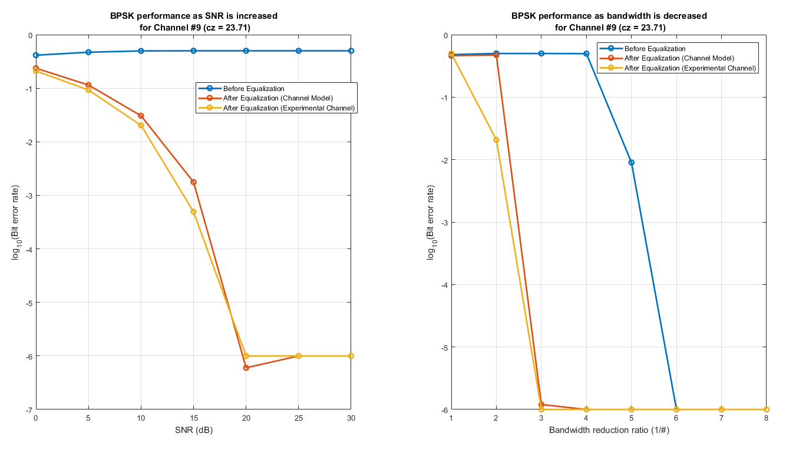
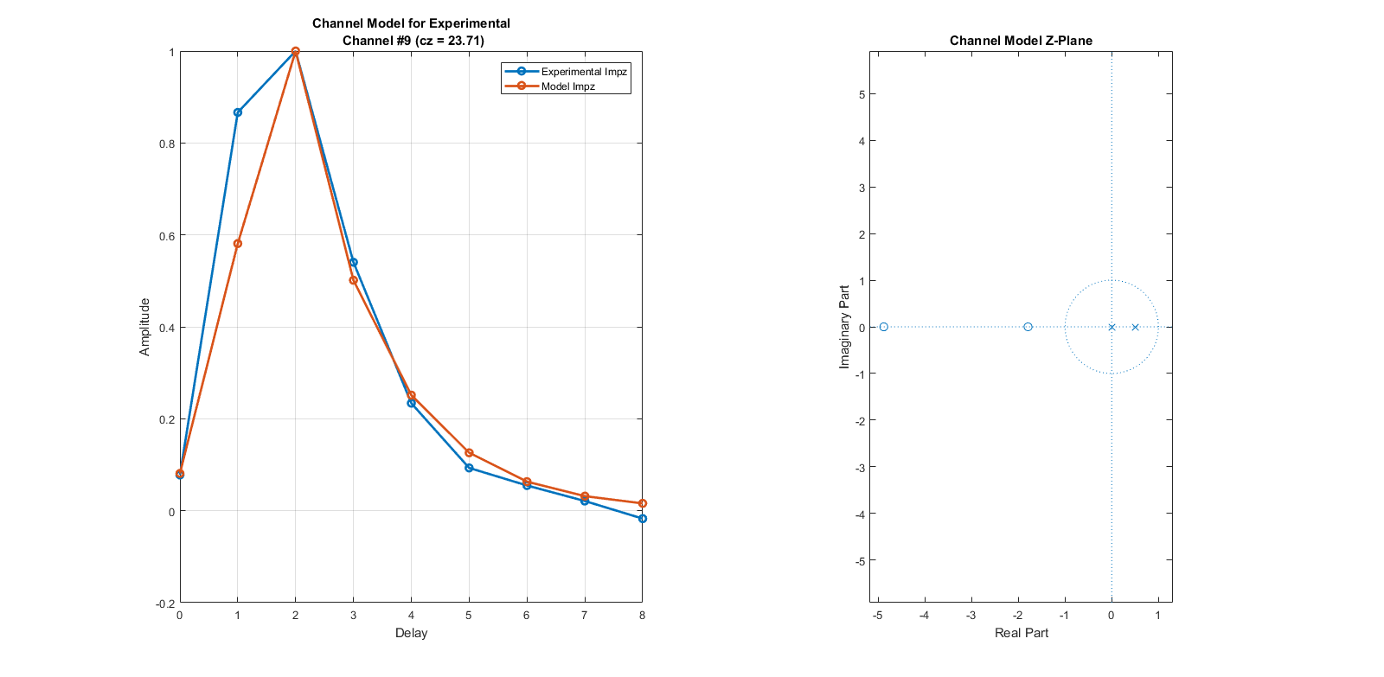
Equalization can keep you going in very turbid water
Multiple scattering dominates
Growing trends: more light appears in delayed samples, and peak of impulse response eventually shifts to the right
Significant ISI observed, forcing reduction in bandwidth
BPSK simulated data transmission for very turbid water (cz = 24) Left: For bandwidth of fs/6, data transmission is impossible in unequalized channel. Equalization allows performance near the BPSK limit. Right: In the equalized case, the data rate must be reduced to fs/6 to hit the 10^-5 BER goal; in the unequalized case, to fs/12. (This is for SNR = 20 dB.)
Channel for turbid water (cz around 29) Left: Impulse response has twice-shifted peak, and slow roll-off, leading to strong ISI. Right: Model has a pole representing the decay in impulse response, and two zero representing the double peak delay.

Slide 10
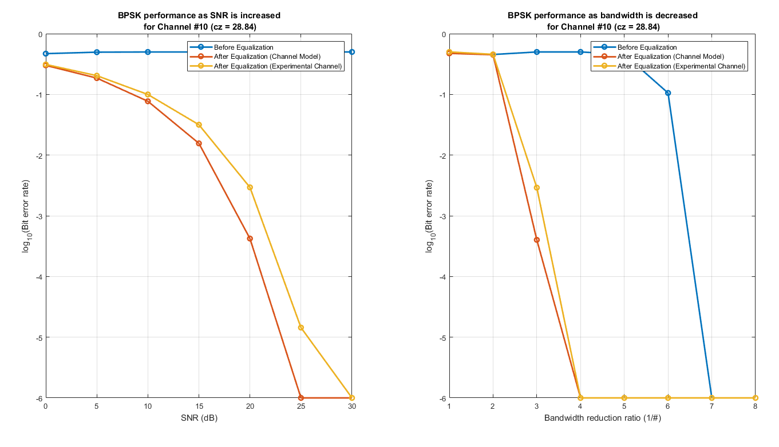
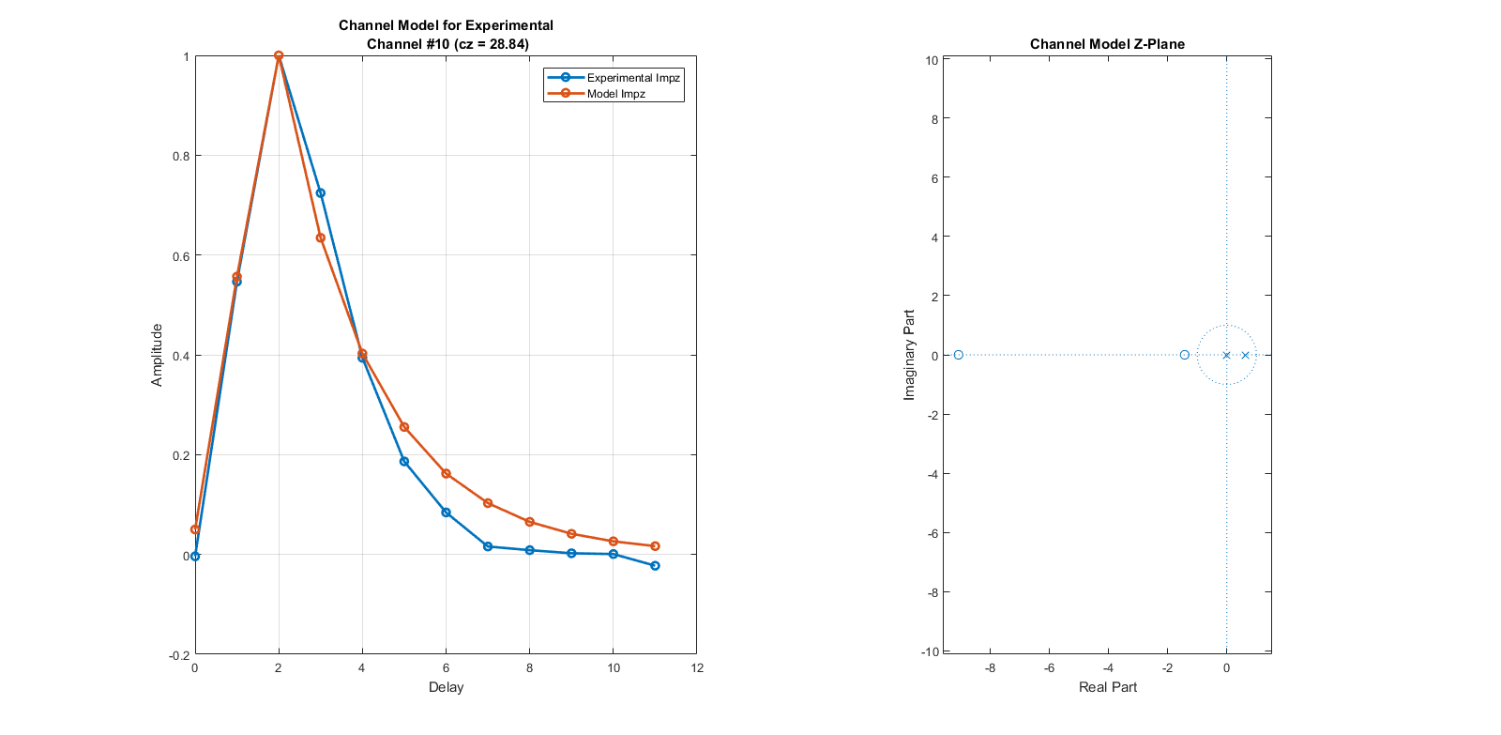
Equalization can keep you going in very [very] turbid water
Multiple scattering dominates
Growing trends: more light appears in delayed samples, and peak of impulse response eventually shifts to the right
Significant ISI observed, forcing reduction in bandwidth
BPSK simulated data transmission for very turbid water (cz = 29) Left: For bandwidth of fs/6, data transmission is impossible in unequalized channel. Equalization allows some performance. Right: In the equalized case, the data rate must be reduced to fs/8 to hit the 10^-5 BER goal; in the unequalized case, to fs/14. (This is for SNR = 20 dB.)
Channel for turbid water (cz around 29) Left: Impulse response has twice-shifted peak, and slow roll-off, leading to strong ISI. Right: Model has a pole representing the decay in impulse response, and two zero representing the double peak delay.

Slide 11
Status: The good and bad news
Good news:
Physics constrains the channel’s evolution significantly
The channel can be modeled reasonably well with just a few parameters (3 parameters works fine)
Single-scatter dominated channels (cz<=10) don’t really have a bandwidth problem
Multiple-scatter dominated channels (cz>=14) do have a bandwidth problem, but equalization helps, with significant improvement relative to non-equalized transmission
Works almost as well on experimental impulse responses as on model
Running adaptively; we don’t know any channel parameters beforehand
Bad news:
Multiple-scatter dominated channels have large-magnitude zeros
These are not directly invertible
This leads to a non-linear phase response and thus an impulse response with moderate ISI at high turbidities

Slide 12
Clear evolution of channel model with turbidity
Pole on positive real axis:
Angle remains at 0
Pole magnitude increases with increasing turbidity, pushing up low frequency response relative to high frequency response
This corresponds to longer tail in impulse response, i.e. lower bandwidth
Zero(s) in left half plane:
Zero appears on negative real axis when there is a rightward shift of peak in impulse response (i.e. net delay in average signal arrival time)
Zero magnitude is always above 1, and it increases with increasing turbidity
Effect is to draw down high frequency response relative to low frequency response
Zero splits into M zeros as delay increases to M samples

